Slide 1
Title I Annual Parent Meeting
Fienberg-Fisher K-8 Center
September 16th, 2014
Ms. Maria G. Zabala, Principal
Ms. Aisha V. Marrero, Assistant Principal
Ms. Mary Murphy, Assistant Principal

Slide 2
What is “No Child Left Behind”?
Education act signed into law in 2002 that aims to:
Ensure that every student has a high-quality education;
Challenge and motivate students;
Provide highly qualified teachers, who use proven teaching methods; and
Ensure a safe, drug free learning environment.

Slide 3
What is Title I?
Title I is the largest federal assistance program for our nation’s schools.
The goal of Title I is a higher quality of education for every child.
The program serves millions of children in elementary and secondary schools each year.
Fienberg-Fisher K-8 Center is a Title I school
What every parent should know about Title I! (brochure)

Slide 4
How Title I Works
The federal government provides funding to states each year for Title I.
The Florida Department of Education sends the money to the district.
The school district identifies eligible schools and provides Title I funds.
Fienberg-Fisher K-8 Center implements the mandated curriculums as well as the IB PYP & MYP Programs.

Slide 5
Annual Measurable Objectives (AMO)
The goal is for all students to be proficient by 2017.
Targets include participation rate and percent proficient in reading, writing, mathematics and graduation rates.
Schools that receive Title I funds must make AMO every year or face consequences.

Slide 6
We are a TIER School
For the past 3 years, Fienberg-Fisher K-8 Center has not meet the AMO targets in the areas of Reading and Math.
Tier I Watch – School Literacy
Tier II - Mathematics

Slide 7
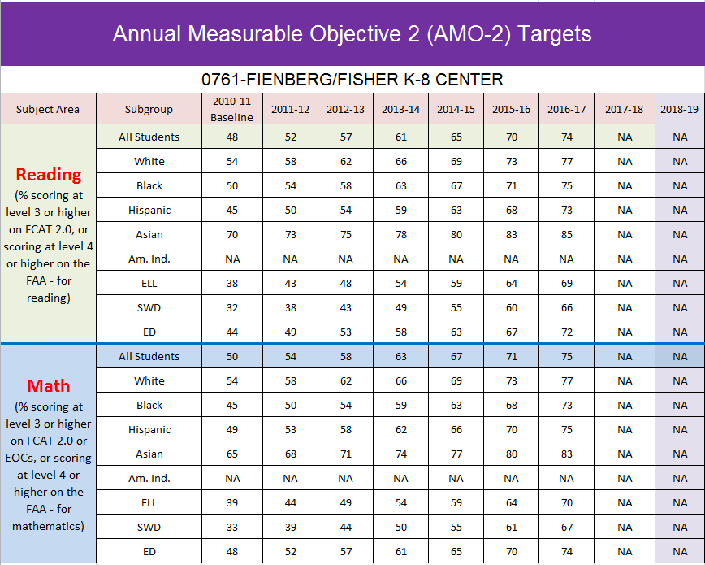

Slide 8
Free Tutoring
Our school uses Title I funds to provide - Free after school tutoring in Reading and Math.
Students eligible to receive free or reduced priced meals are eligible for the free tutoring.

Slide 9
School Choice
As a parent of a child enrolled in a school identified as in need of improvement for two or more years, you have the choice to transfer your child to a higher performing school.
Transportation to the new school of choice is provided by the district at no cost to the family.

Slide 10
Parent’s Rights
Be involved and request regular meetings to express your opinions and concerns;
Be provided information on your child’s level of achievement on assessments like Florida Standards Assessment (FSA) in reading/language arts, and mathematics, and/or (FCAT 2.0) for science. SAT-10 for grades K-2 and EOC Exams.
Request and receive information on the qualifications of your child’s teacher; and
Be informed if your child is taught by a non-highly qualified teacher for four or more consecutive weeks.

Slide 11
School Accountability Report Card
School Public Accountability Report (SPAR) provides parents and the community with important information about each public school
Demographic data;
School safety and climate for learning information;
Academic data;
Graduation rates;
Class sizes;
Teacher and staff information;
Curriculum and instruction descriptions;
Postsecondary preparation information; and
AMO information.
Available at the school office or online at
http://doeweb-prd.doe.state.fl.us/eds/nclbspar/index.cfm

Slide 12
Fienberg-Fisher K-8 Center
2014 | Reading (3rd – 8th) | Math (3rd – 8th) | Science (3rd – 8th) | Writing (3rd – 8th) | Grade Points (3rd – 8th)
%Meeting High Standards | 50 | 50 | 52 | 50 | 203
% of Students Making Learning Gains | 75 | 73 |  |  | 148
Adequate Progress of Lowest 25% or Lowest 30 Students in the School? | 79 | 73 |  |  | 152
School Grade Points |  |  |  |  | 574
Percent Tested = 99%
School Grade |  |  |  |  | B
* 71 pts - Middle School Acceleration and Participation in EOCs

Slide 13
Educational Standards
Florida’s academic content standards establish high expectations for all students.
Florida State Standards identify what your child needs to know and be able to do in English/Language Arts and Mathematics.
Next Generation Sunshine State Standards identify what your child needs to know and be able to do in Science and Social Sciences.
Information located at: http://www.floridastandards.org/Standards/FLStandardSearch.aspx

Slide 14
Guess what grade level?
I know how to use quotation marks to show that someone is speaking. Example: Mary said, “Hello there.”
I can count, read, and write whole numbers to 10,000
Teachers will discuss standards and speak about curricular expectations in the classroom.

Slide 15
School’s Curriculum
Florida State Standards and Next Generation Sunshine State Standards form the framework of everything taught at school.
Curriculum
Reading/Language Arts (ELA)
Mathematics
Writing
Science

Slide 16
Measuring Student Success
Florida State Assessment (FSA) – Grades 3 – 11 ELA & Math
Florida Comprehensive Assessment Test (FCAT)—Grades 5 & 8 Science
Stanford Achievement Test, 10th Edition (SAT10)—Grades K-2
Florida Assessment for Instruction in Reading (FAIR)
Interims, Quarterly, CELLA, End of Course (EOC) - Algebra I and Civics, Hard to Assess Subjects (HAS) – Art, Music, PE

Slide 17
Testing Schedule
March 2 - 13 | Florida Standards Assessments English Language Arts - Writing Component | FSA | Grade 4; and Grades 5-11 CBT* | Federal and State
March 2 - April 7 | Florida Alternate Assessment | FAA | Grades 3-11*** | State
March 16 - April 2 | Florida Comprehensive Assessment Test Reading and Mathematics Retakes CBT* | FCAT/FCAT 2.0 RETAKE | Grades 10+, 11, 12 eligible students | State
 | Florida Next Generation Sunshine State Standards End-of-Course Assessments Algebra 1 Retake CBT* | NGSSS EOC RETAKE | Grades 7-12,eligible students | Federal and State
March 16 - April 10 | Florida Standards Assessments English Language Arts and Mathematics | FSA | Grades 3 and 4 | Federal and State

Slide 18
Testing Schedule
April 13 - 17 | Stanford Achievement Test, Tenth Edition Reading and Mathematics | SAT-10 | Grades K-2 | District
April 13 - May 8 | Florida Comprehensive Assessment Test 2.0 Science | FCAT 2.0 | Grades 5 and 8 | Federal and State
 | Florida Standards Assessments English Language Arts CBT* | FSA | Grades 5-11
 | Mathematics CBT* |  | Grades 5-8
April 13 - May 29 | Florida Assessments for Instruction in Reading Assessment Period 3 (AP3) | FAIR-FS | Grades K-3, all students; Grades 4-10, Levels 1 & 2; Grades 11-12, Retake** | State
April 20 - May 15 | Forida Standards Assessments: End-of-Course Assessments Algebra 1, Geometry, and Algebra 2 CBT* | FSA EOC | Grades 6-12, eligible students | Federal and State
April 20 - May 22 | Florida Next Generation Sunshine State Standards End-of-Course Assessments Biology 1, Civics, and US History | NGSSS EOC | Grades 6-12, eligible students | Federal and State

Slide 19
Title I Programs Provide Supplemental Support
Smaller classes;
Additional teachers and paraprofessionals;
Additional training for school staff;
Extra time for instruction (Before and/or after school programs);
Parental Involvement Activities; and/or
A variety of supplemental teaching methods and materials.

Slide 20
Title I funds
Fienberg-Fisher K-8 Center was allocated $158,184.00 for this school year. We use these funds to pay for services and programs for our students:
One Teacher
One Community Involvement Specialist (CIS)
Hourly Funds – To fund Interventionist and After School Tutors

Slide 21
Who decides how funds are used?
Every school has a Educational Excellence School Advisory Council (EESAC) composed of:
Parents, Teachers, Community Members, other staff that works at the school, Principal and Students (at Middle and High School)
The School Advisory Council determines how to use Title I funds.

Slide 22
Working together!
Title I law requires that all Title I schools and families work together.
How we work together is listed in our:
School Level Parental Involvement Policy;
Parent-School Compact; and
Schoolwide Improvement Plan Title I Plan

Slide 23
Parent-School Compact
School will:
Annual orientation meetings
Involve parents in planning, reviewing and improving the PIP
High Quality Curriculum and instruction
Host parent-teacher conferences
Provide parents with reports on student progress
Provide reasonable access to staff
Provide opportunities for parents to volunteer
Parents will:
Monitor attendance, school learning
Become involved in planning, reviewing and improving the PIP
Volunteer
Communicate with my child’s teacher
Participate in meetings to my child
Stay informed about my child’s education
Serve on policy advisory groups

Slide 24
Parent Involvement
Policy Requirements
Involve parents in a meaningful way in the development, implementation, and review of the parental involvement program.
Parental Involvement:
EESAC
IB Meetings
PTA
Meeting Times
EESAC – 1st Wed. of the Month
IB Meetings monthly or bi-monthly
PTA - monthly
Maria Cruz, EESAC Chair

Slide 25
Parent Involvement
Policy Requirements
Convene an annual meeting to inform parents of Title I students of Title I requirements and their rights to be involved in the Title I program.
Offer meetings at flexible times to maximize participation

Slide 26
Parent Involvement
Policy Requirements
Provides parents of Title I students with timely information about Title I programs.
Connect-Ed, Calendars, Flyers, IB Letters
What works for you?

Slide 27
Parent Involvement
Policy Requirements
Assists parents in understanding academic content standards, assessments, and how to monitor and improve the achievement of their children.
Open House
IB Meetings
FSA Night
SAT-10 Night
Head Start Parent Committee Meetings
EESAC

Slide 28
Parent Involvement
Policy Requirements
Provides materials and training to help Title I parents work with their children to improve their children's achievement
Parent Academy
CIS
IB Meetings
Open House
SAT-10 Night
FSA Night
Head Start Committee Meetings

Slide 29
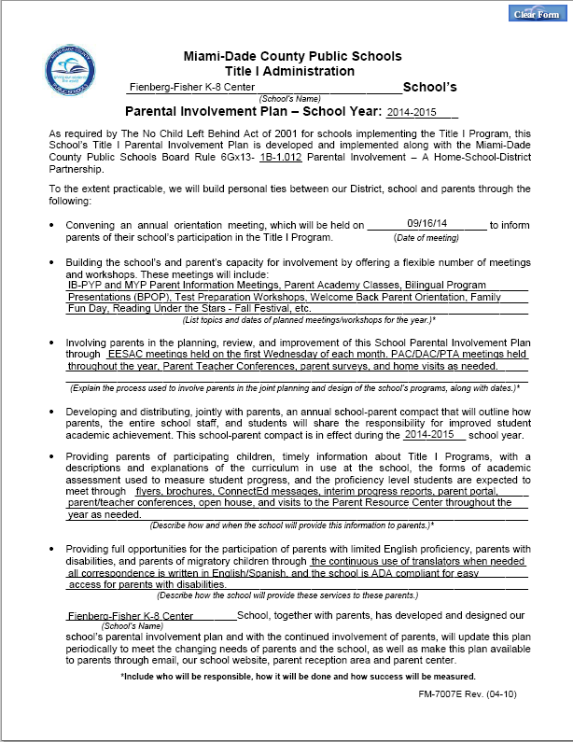

Slide 30
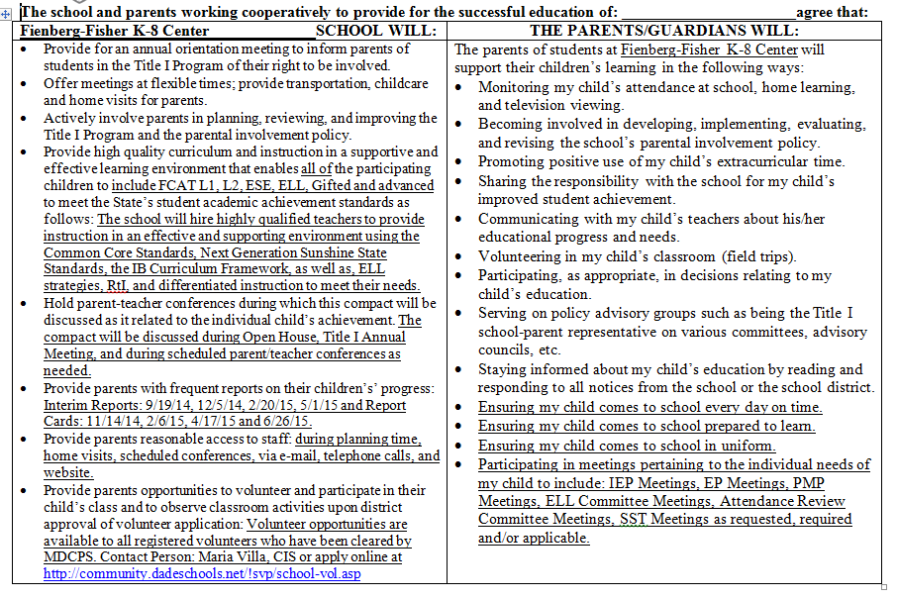

Slide 31
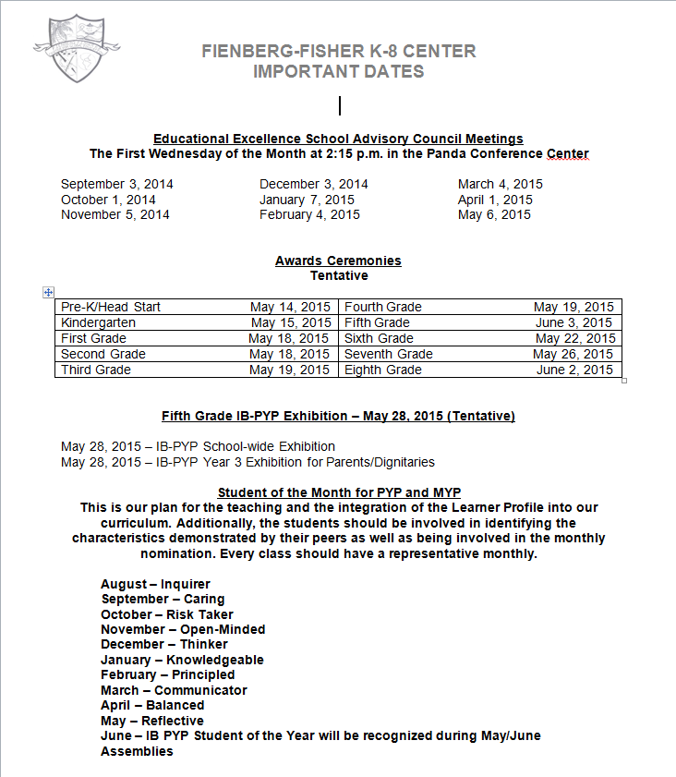

Slide 32
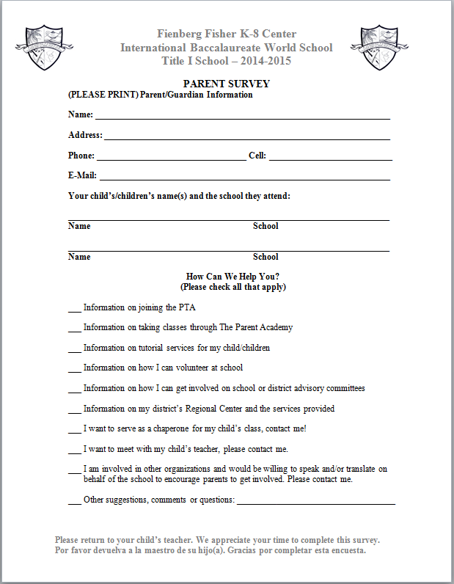

Slide 33
Your involvement is Key to your child’s success!
You are your child’s first teacher.
You have the ability to influence your child’s education more than any teacher or school.
You know your child best:
Share information about your child’s interests and abilities with teachers; and
Ask to see progress reports on your child and the school.

Slide 34
Support Your Child’s Education
Share a love of learning;
Read to your child;
Ask your child to read to you;
Limit TV time;
Take advantage of the public library and the school media center;
Show interest in your child’s school day;
Ask questions;
Ask to see homework;
Praise their efforts; and
Encourage good study habits.

Slide 35
Get to Know Your School & Communicate With Teachers
Attend school events
Visit the classroom
Volunteer at the school
Join parents’ organizations
Keep teachers informed
Attend special parent trainings
Attend parent-teacher conferences
Be prepared for the meetings
Consider whether you have met your responsibilities as stated in the parent-school compact
List your questions before the meeting

Slide 36
Classroom Visits
Teachers will provide grade specific information:
Florida Standards, Next Generation Sunshine State Standards and Grade Level Expectations;
Grade Specific Curriculum;
Measuring Student Success;
Definition of Proficiency; and
Overview of their plans for the year;
Title I Survey
How parents can help their child.

Slide 37
Questions?
Thank you for attending.

